Slide 1

DPW-8 & AePW-4 Buffet Working Group Mini Workshop 2
May 20, 2025
Virtual
https://aiaa-dpw.larc.nasa.gov
https://nescacademy.larc.nasa.gov/workshops/AePW4/public

Slide 2
Mini Workshop Scope
Check-in for results submitted and lessons learned to date
Identify opportunities for further improvement
Establish the foundation for upcoming AVIATION papers
Additional analysis is coming for AVIATION

Slide 3
Data Set Summary
Many submissions
74 submissions
18 parties
Most full data sets, some partial (e.g., no F&M or sectional cuts)
Multiple schemes
RANS (majority)
URANS (most common unsteady scheme)
HRLES
WMLES
Adaptive Euler
Grids
Cadence (majority)
Custom (few provided for posting to the website)
Helden

Slide 4
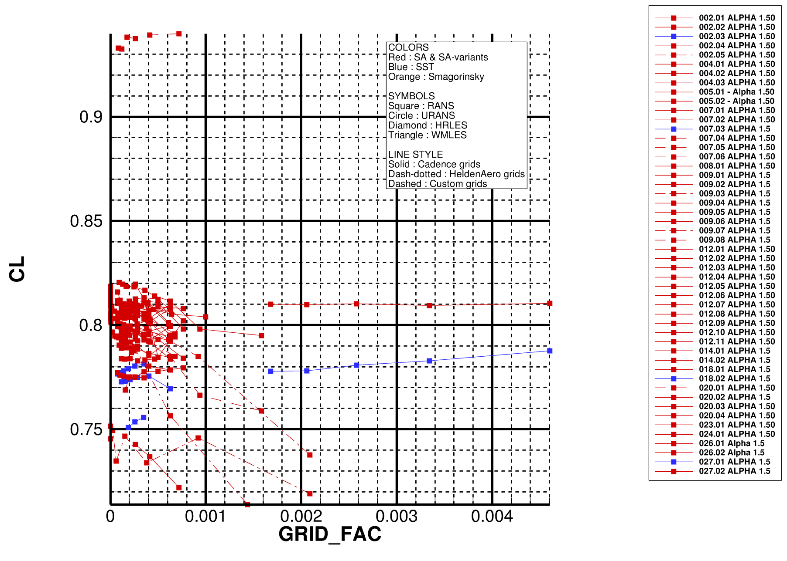
Test Case 1a : Grid Study at AoA=1.50deg
Will make same plots for CD and CM
See later, but there are some evident outliers (002, 006, 009, 014, 020, 023, 027)

Slide 5
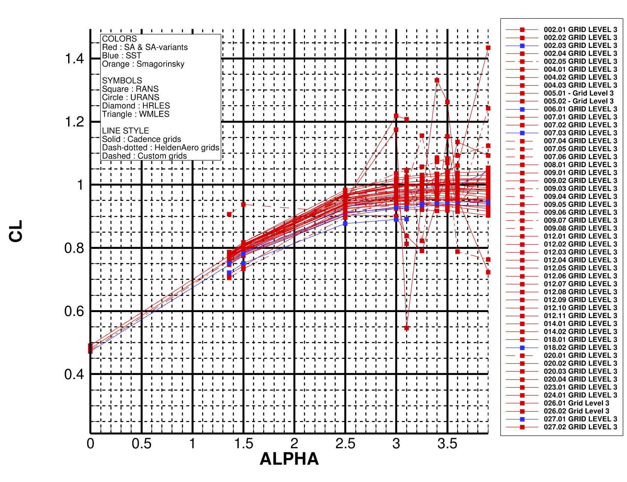
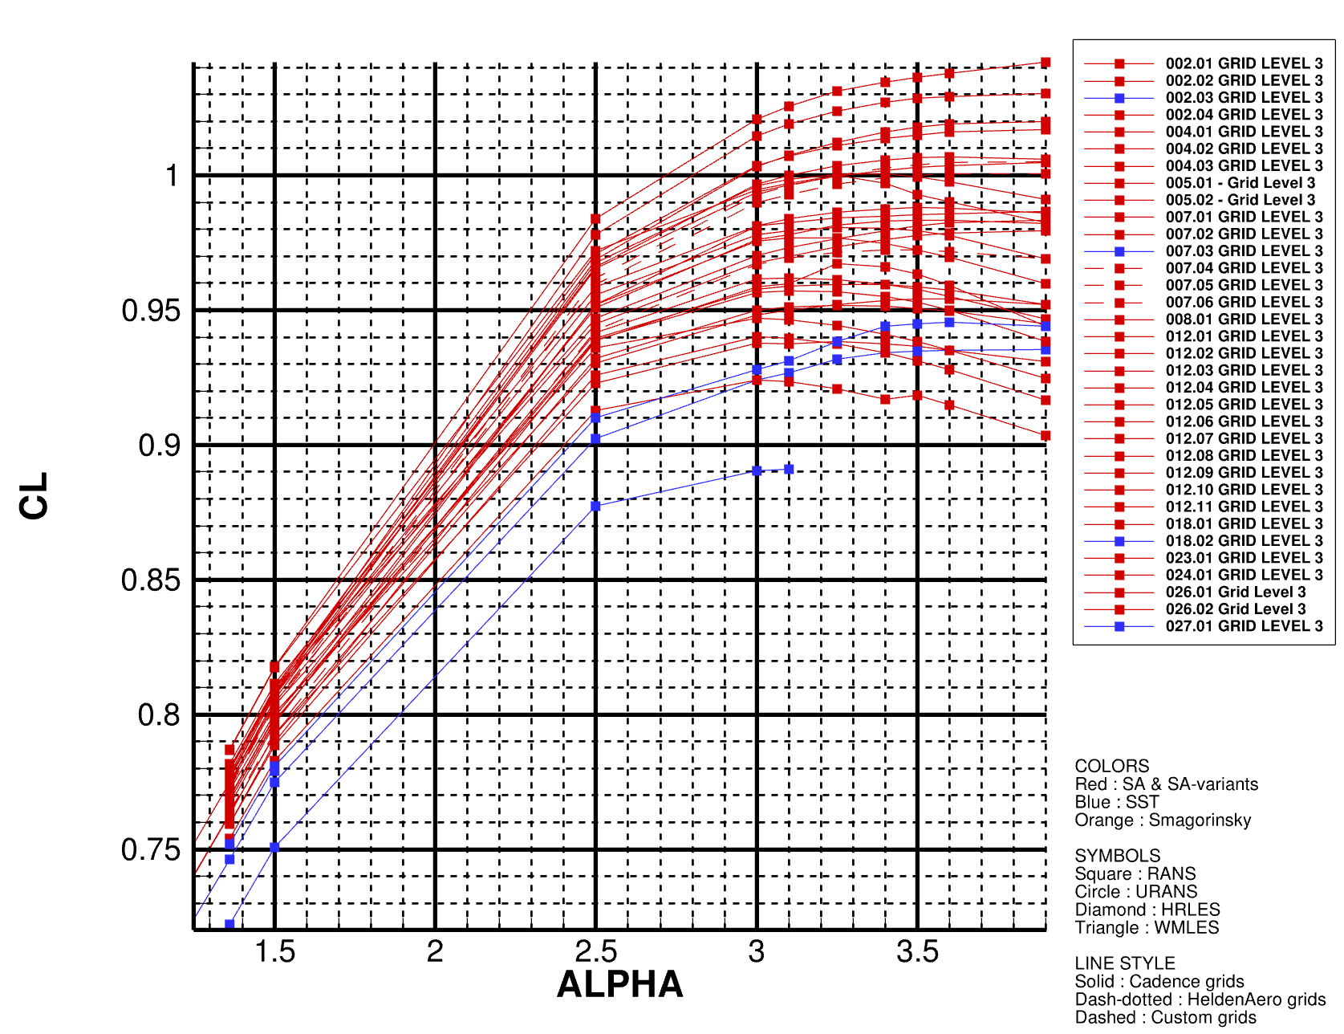
Test Case 1a : Alpha-sweep
ALL test case 1a submissions
Without outliers
Some evident outliers : 002, 006, 009, 014, 020, 023, 027

Slide 6
Test Case 1a : Alpha-sweep (without outliers)
Consistent trends but large scatter
~40 counts at low AoAs
~150 at high AoAs
Will make more plots for different SA flavors

Slide 7
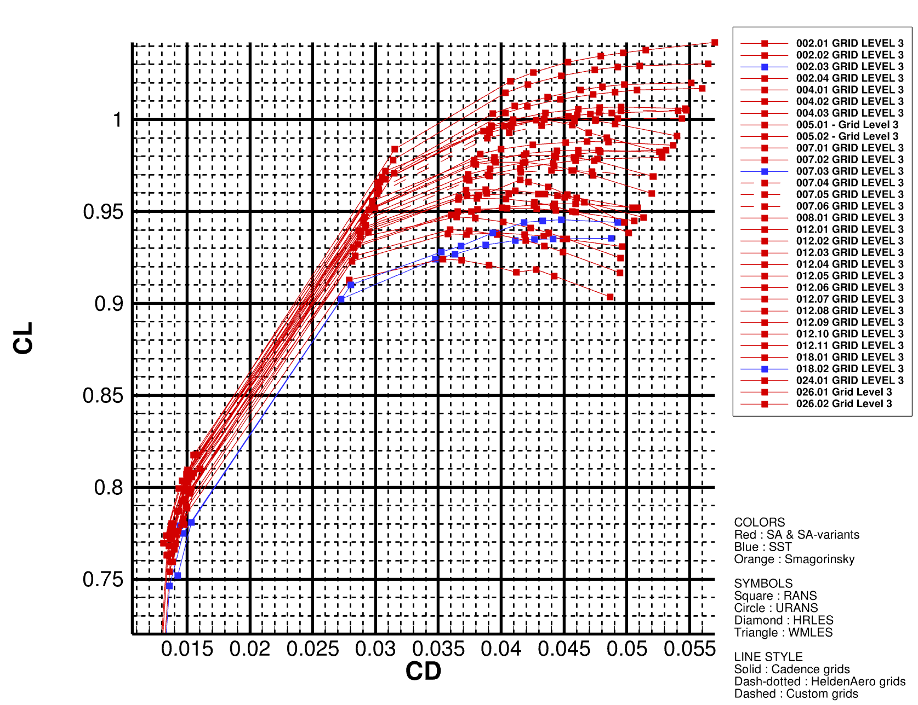
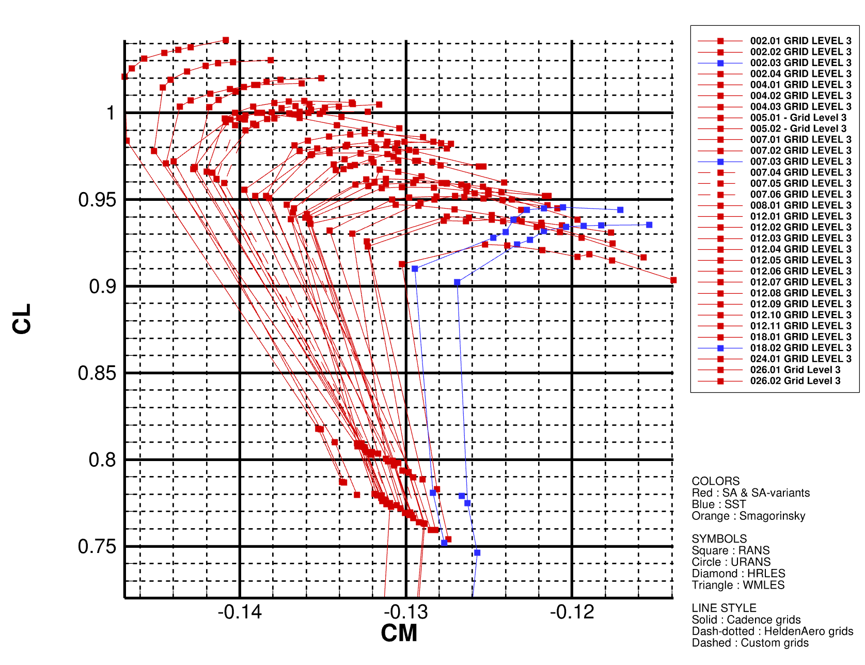
Test Case 1a : Alpha-sweep (without outliers)

Slide 8
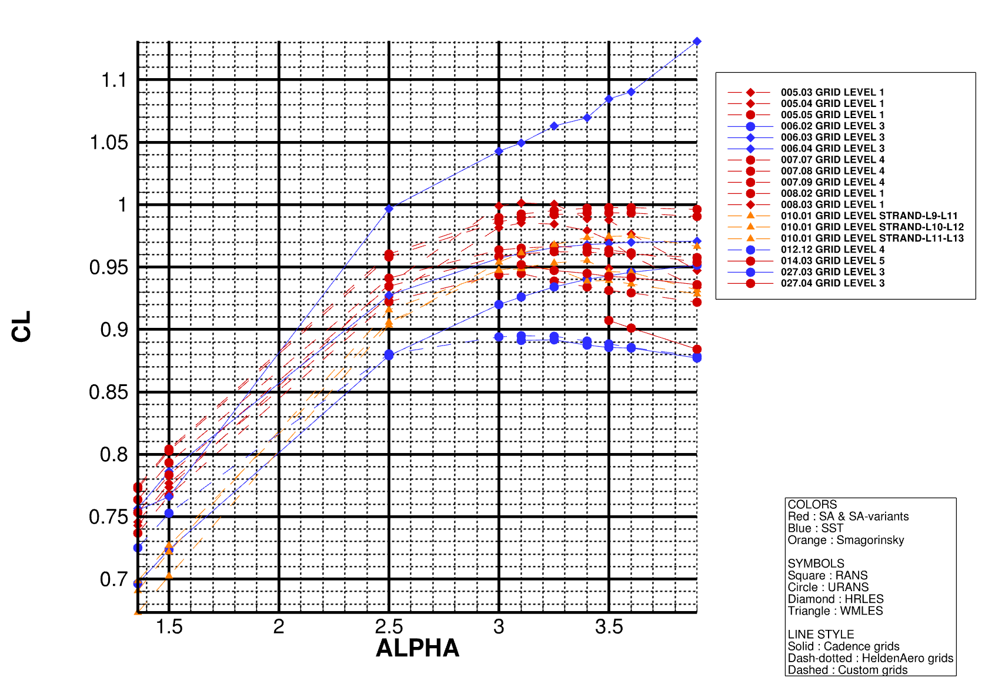
Test Case 1b : Alpha-sweep (with outliers)
Some outliers again

Slide 9
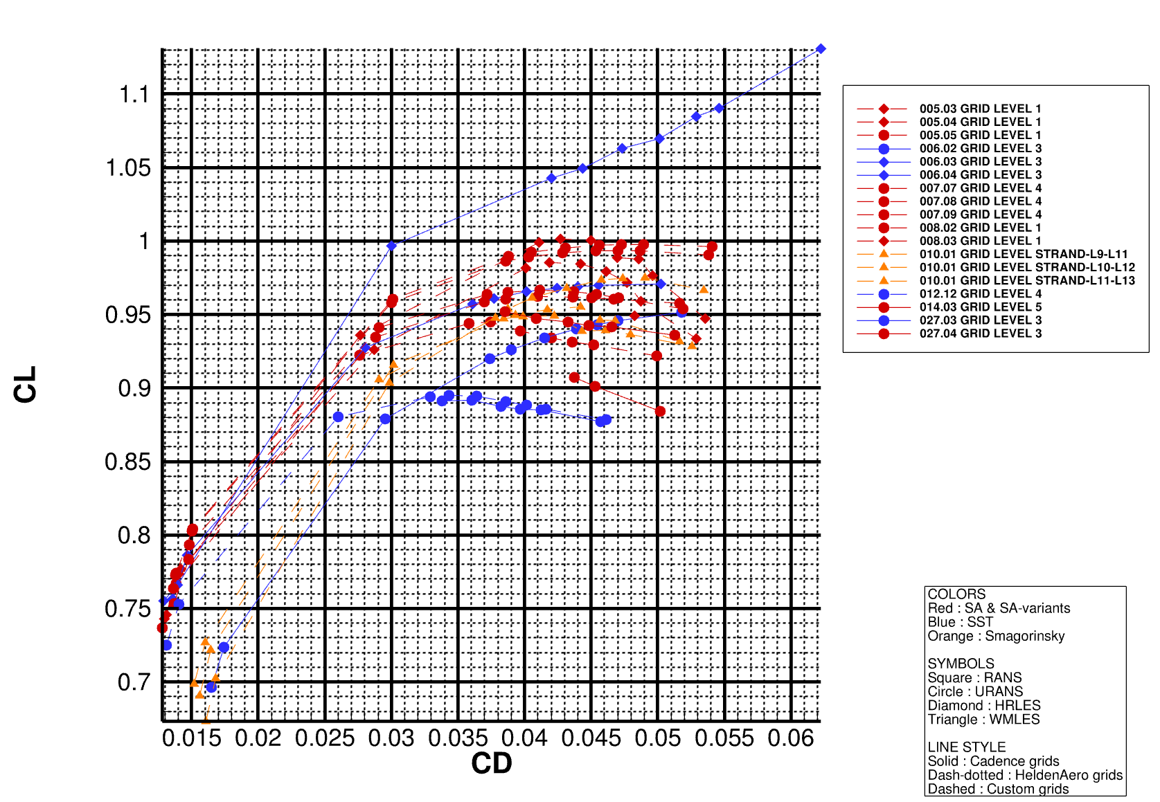
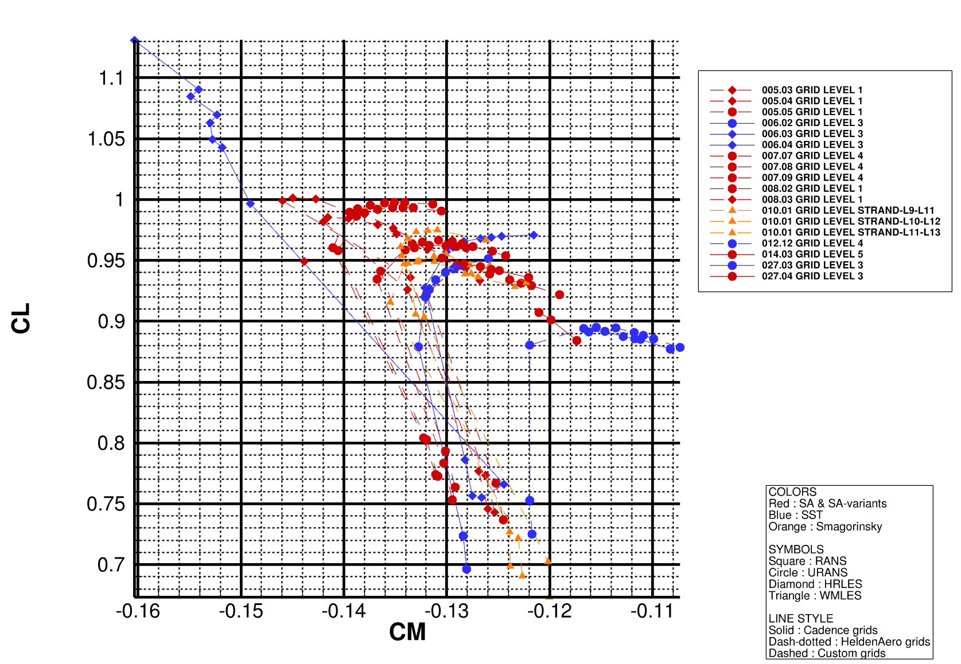
Test Case 1b : Alpha-sweep (with outliers)

Slide 10
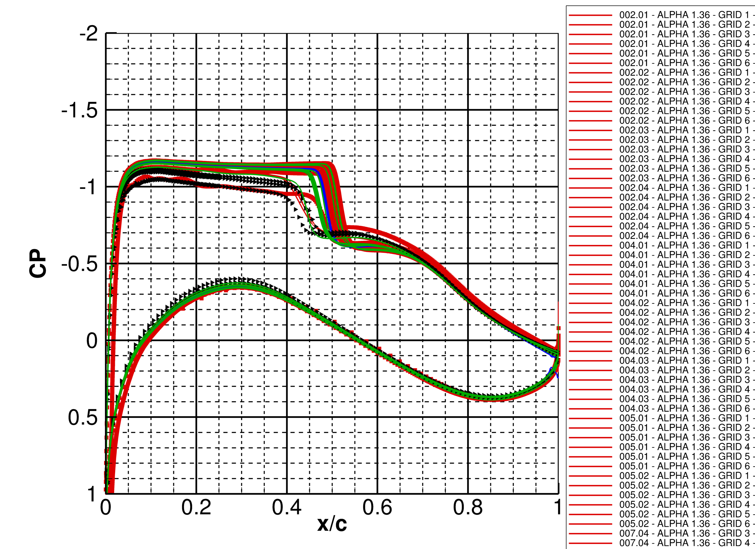
1.36
Red: RANS
Green: URANS
Blue: HRLES
Black Triangles: WMLES

Slide 11
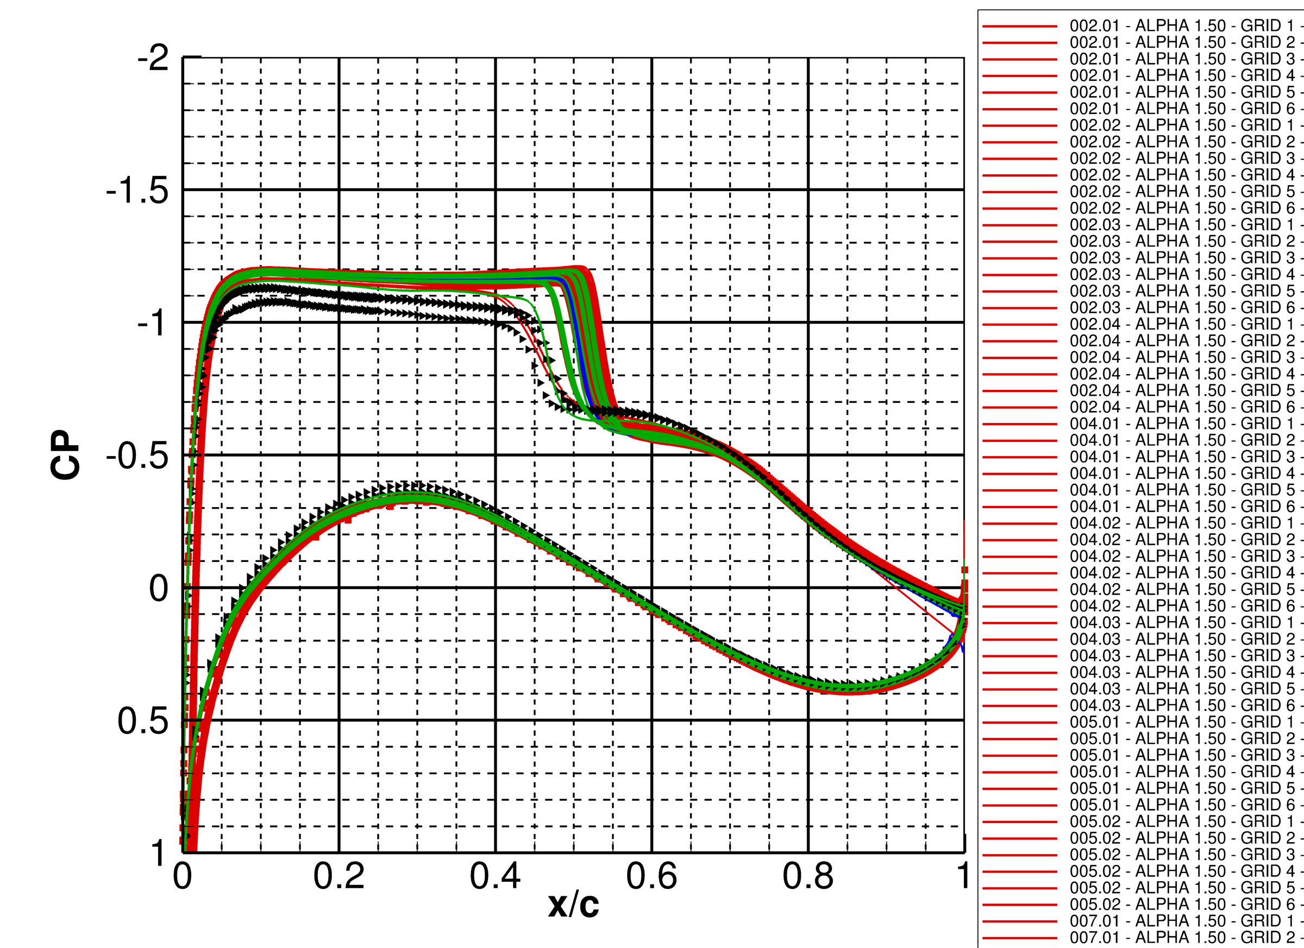
1.50
Red: RANS
Green: URANS
Blue: HRLES
Black Triangles: WMLES

Slide 12
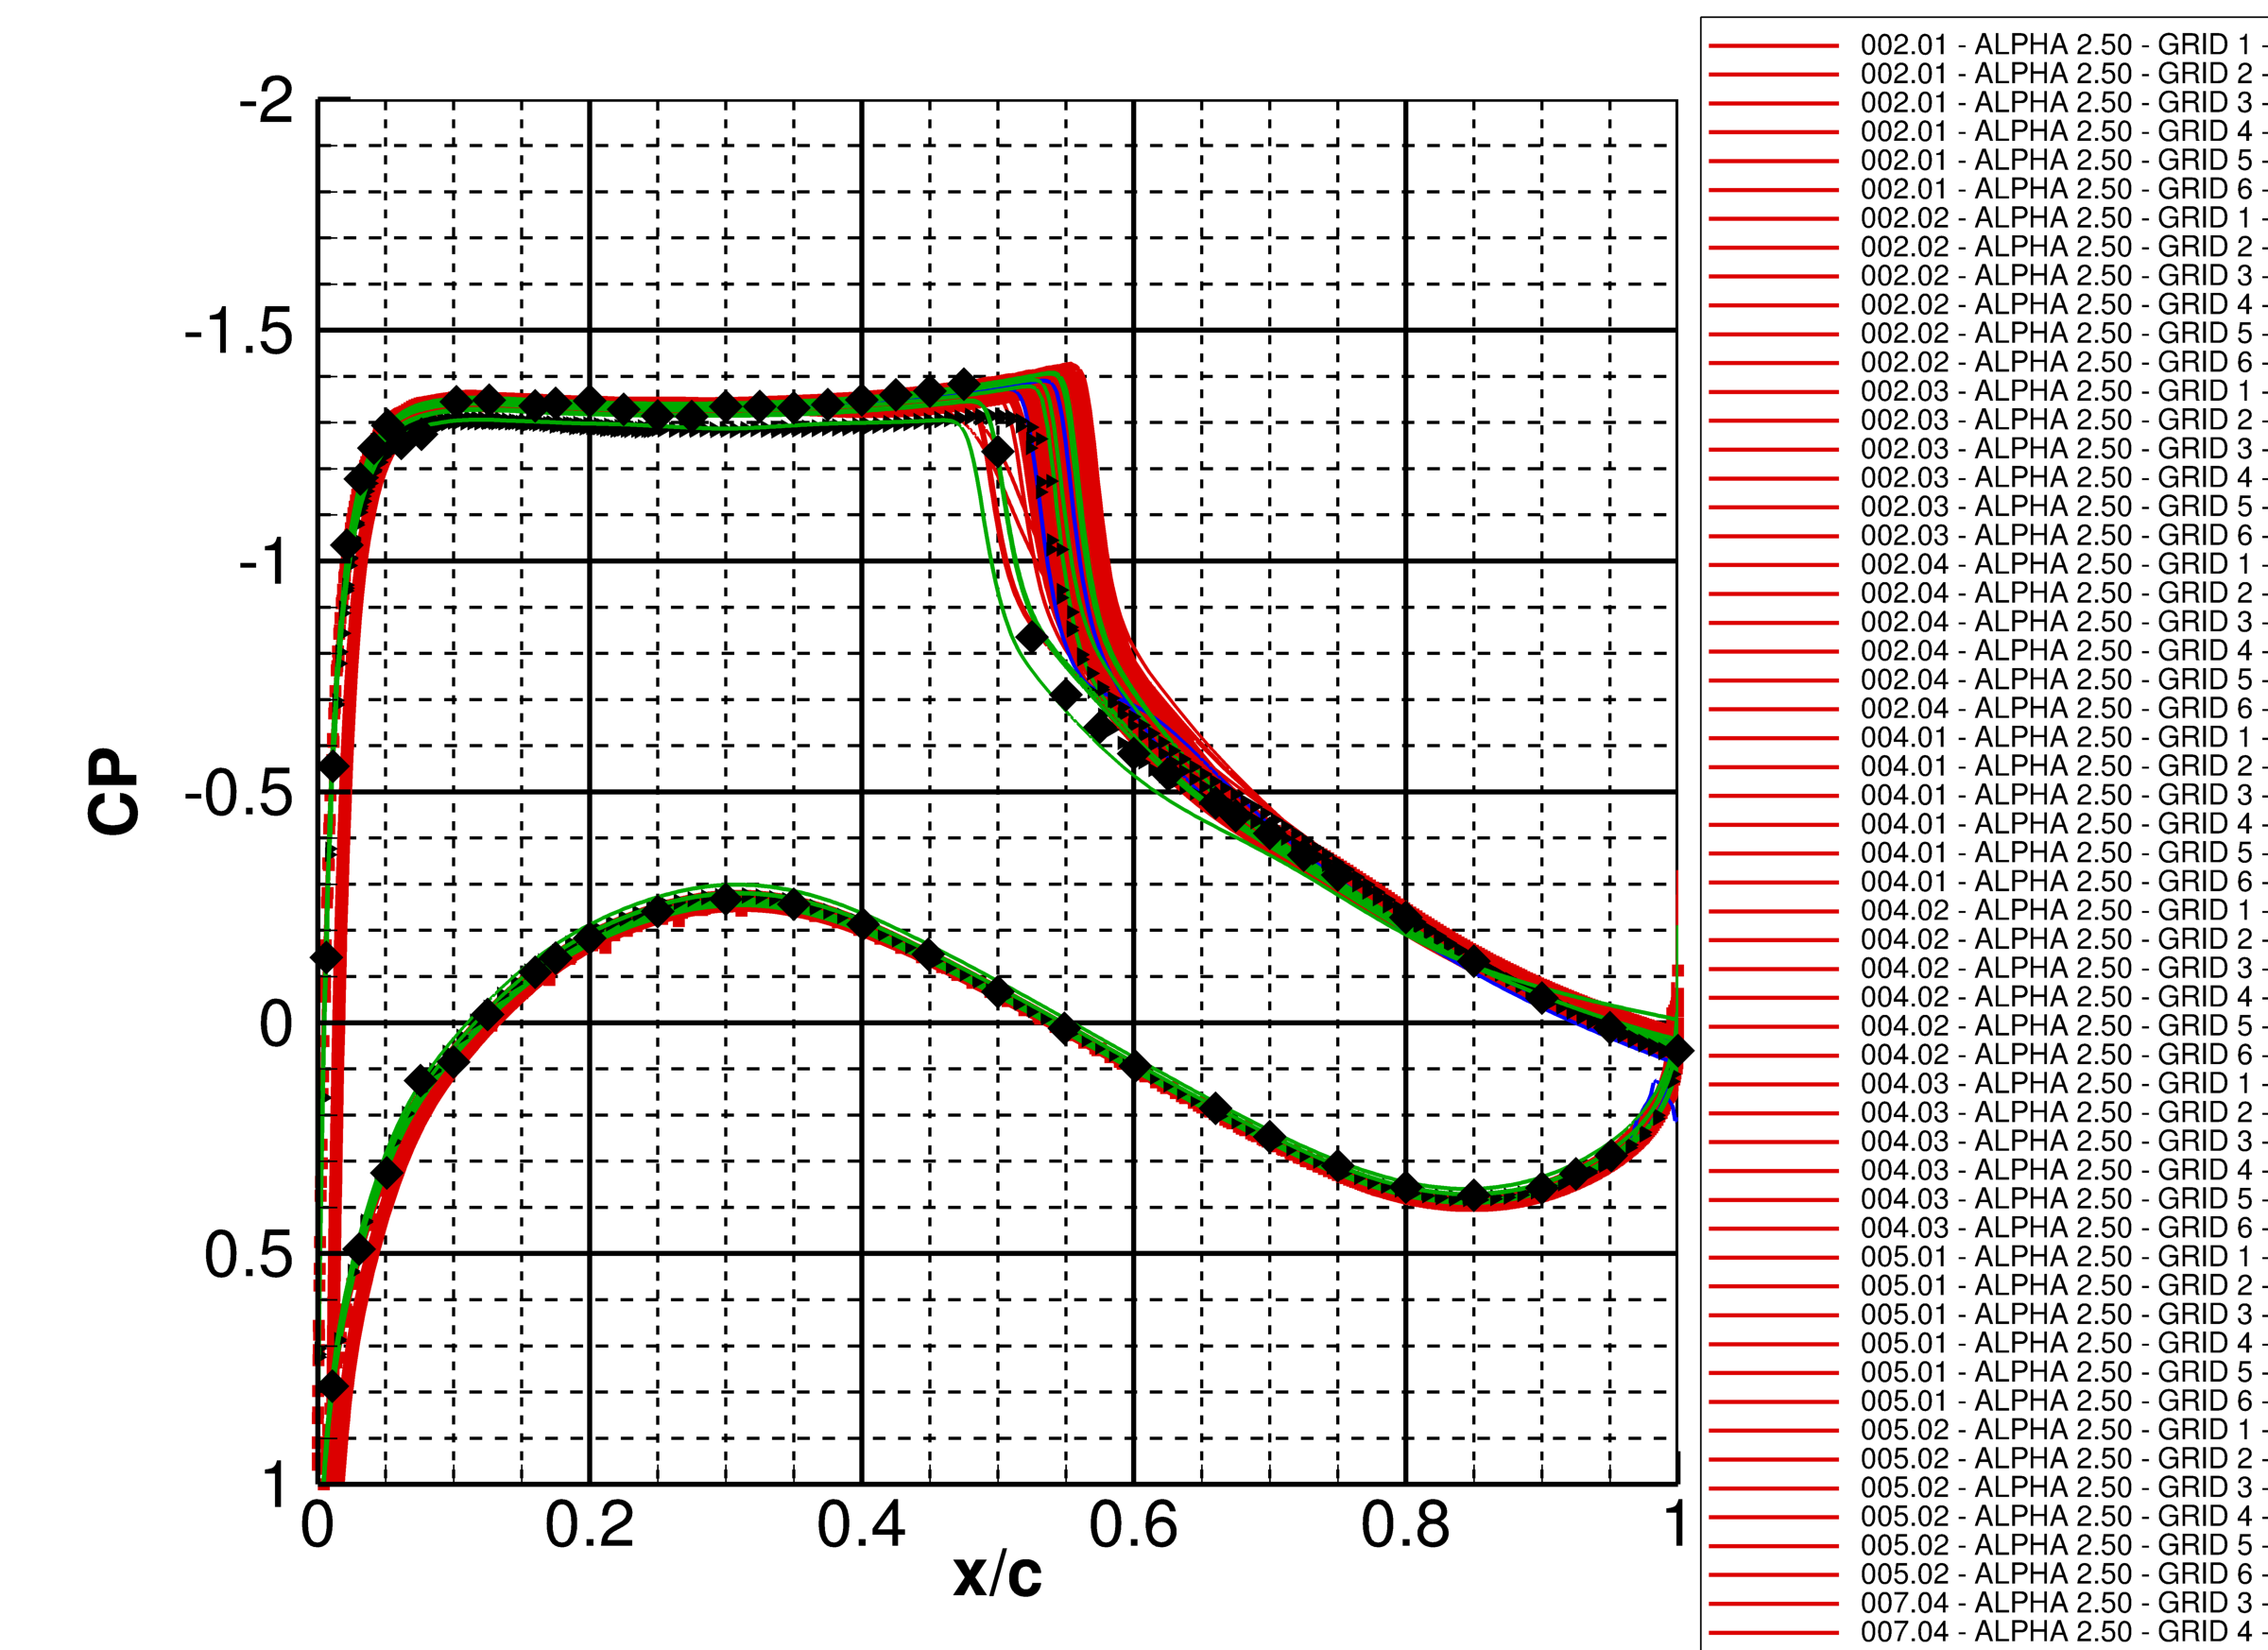
2.50
Red: RANS
Green: URANS
Blue: HRLES
Black Triangles: WMLES

Slide 13
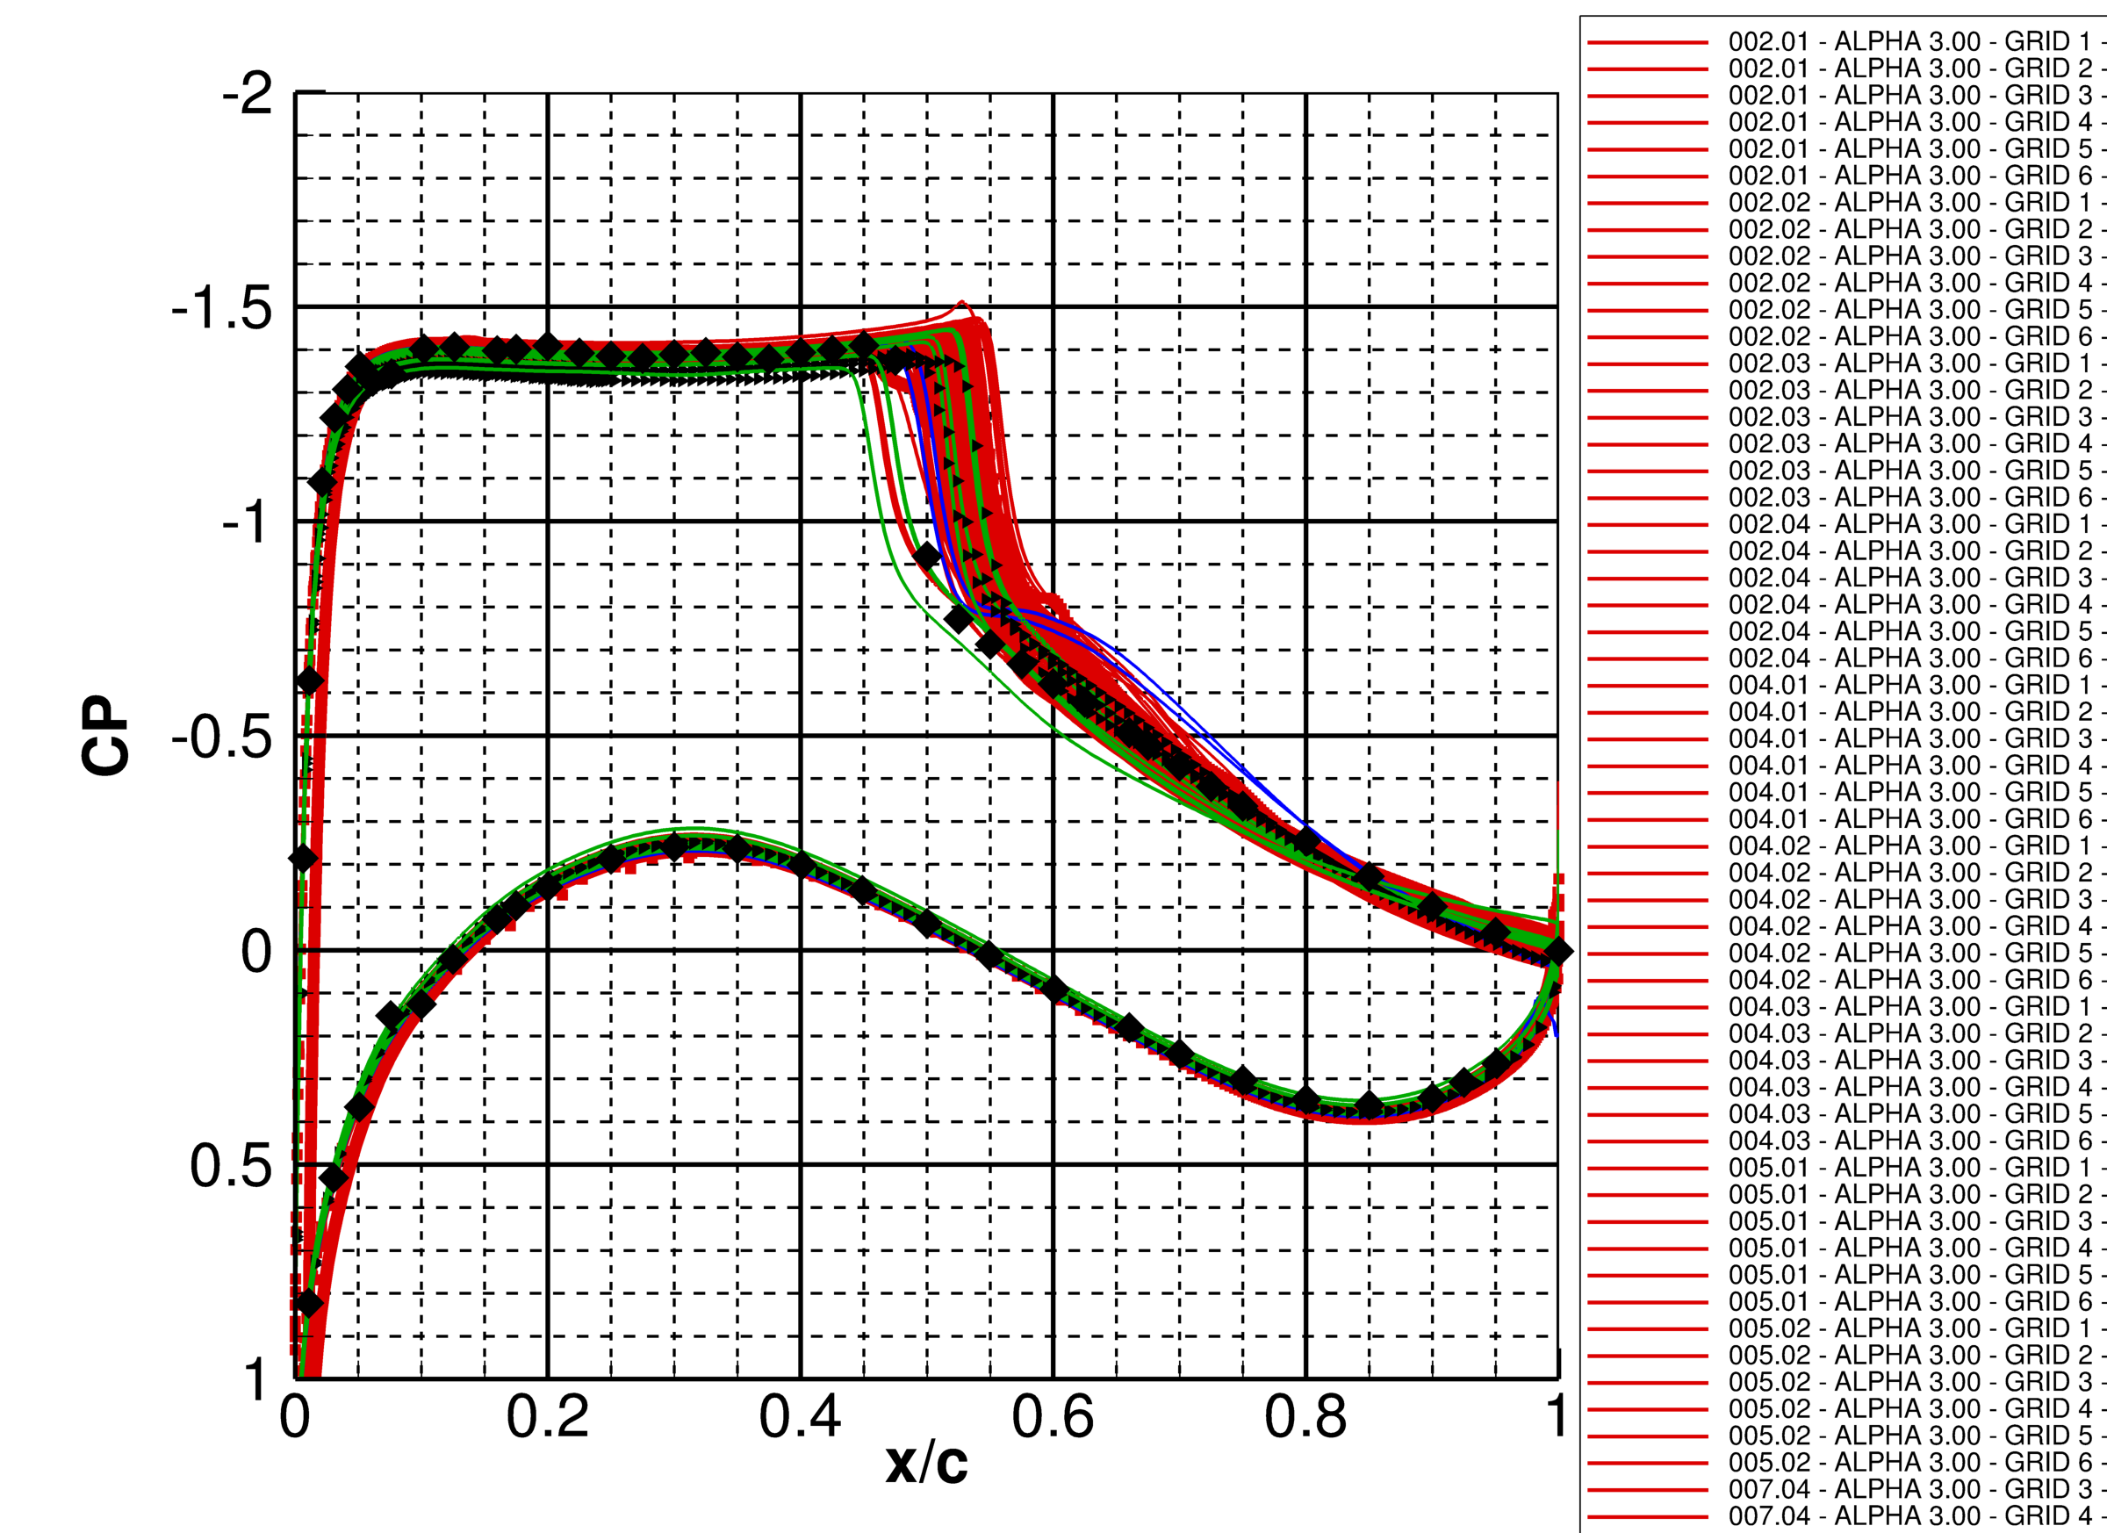
3.00
Red: RANS
Green: URANS
Blue: HRLES
Black Triangles: WMLES

Slide 14
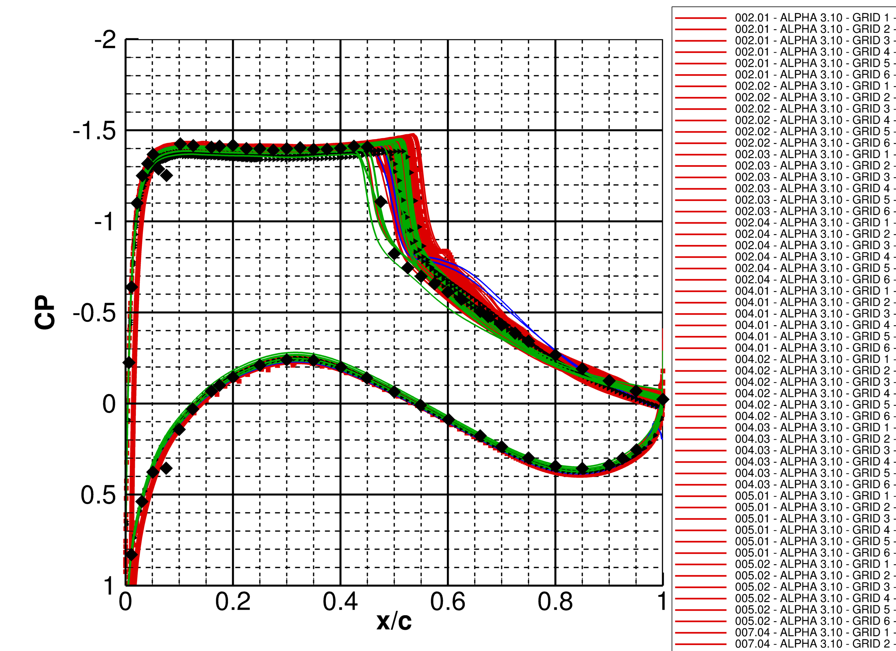
3.10
Red: RANS
Green: URANS
Blue: HRLES
Black Triangles: WMLES

Slide 15
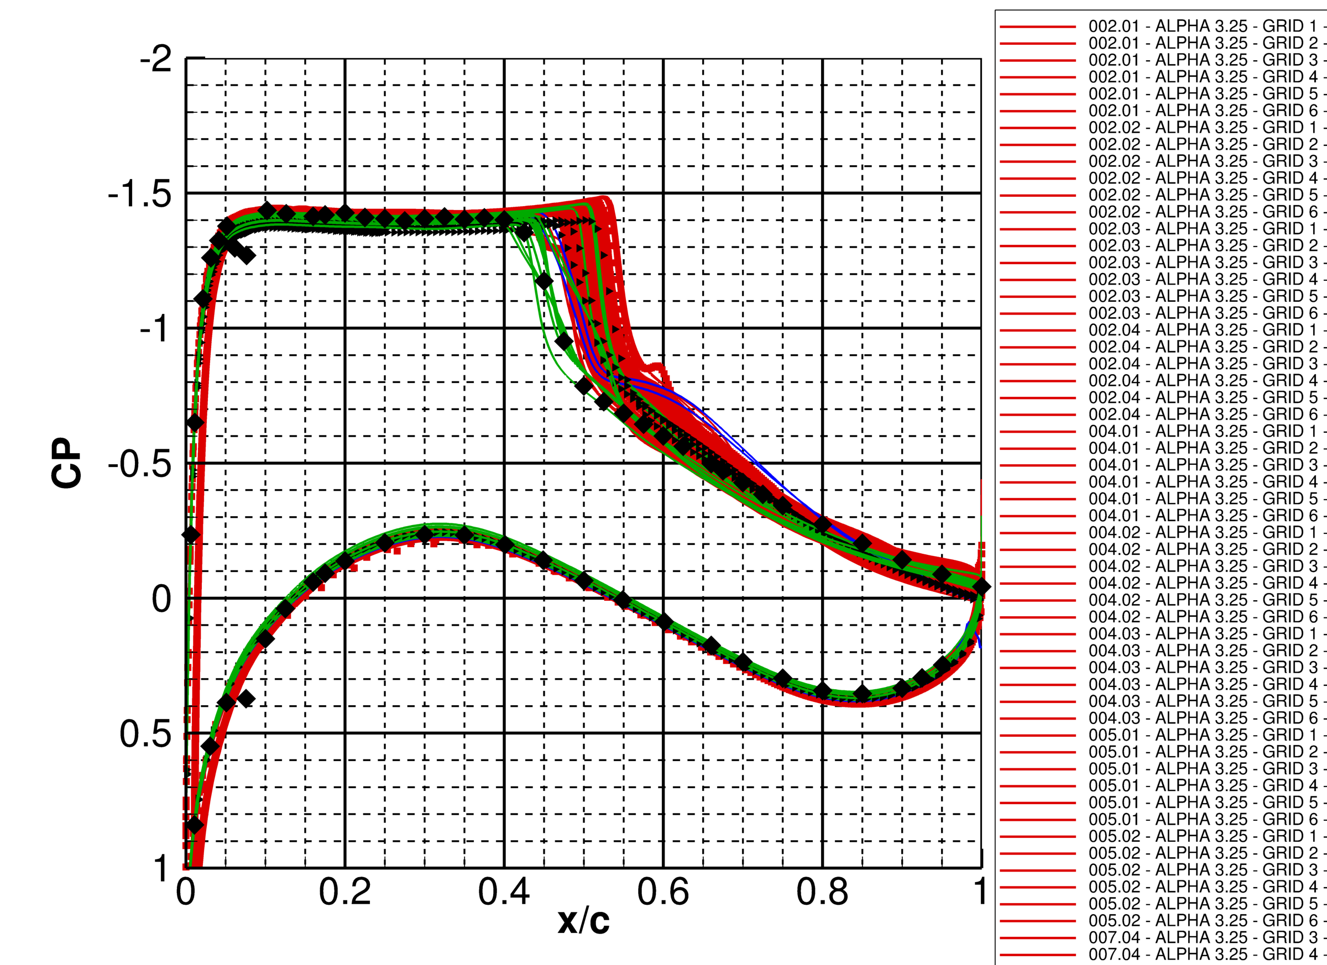
3.25
Red: RANS
Green: URANS
Blue: HRLES
Black Triangles: WMLES

Slide 16
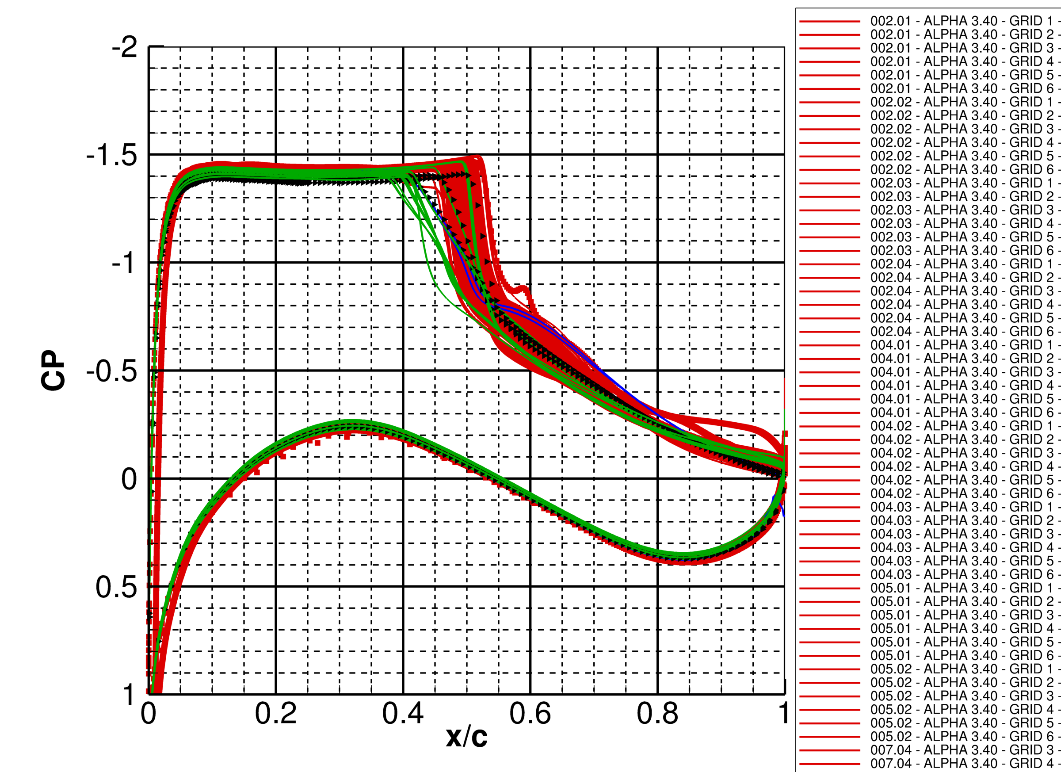
3.40
Red: RANS
Green: URANS
Blue: HRLES
Black Triangles: WMLES

Slide 17
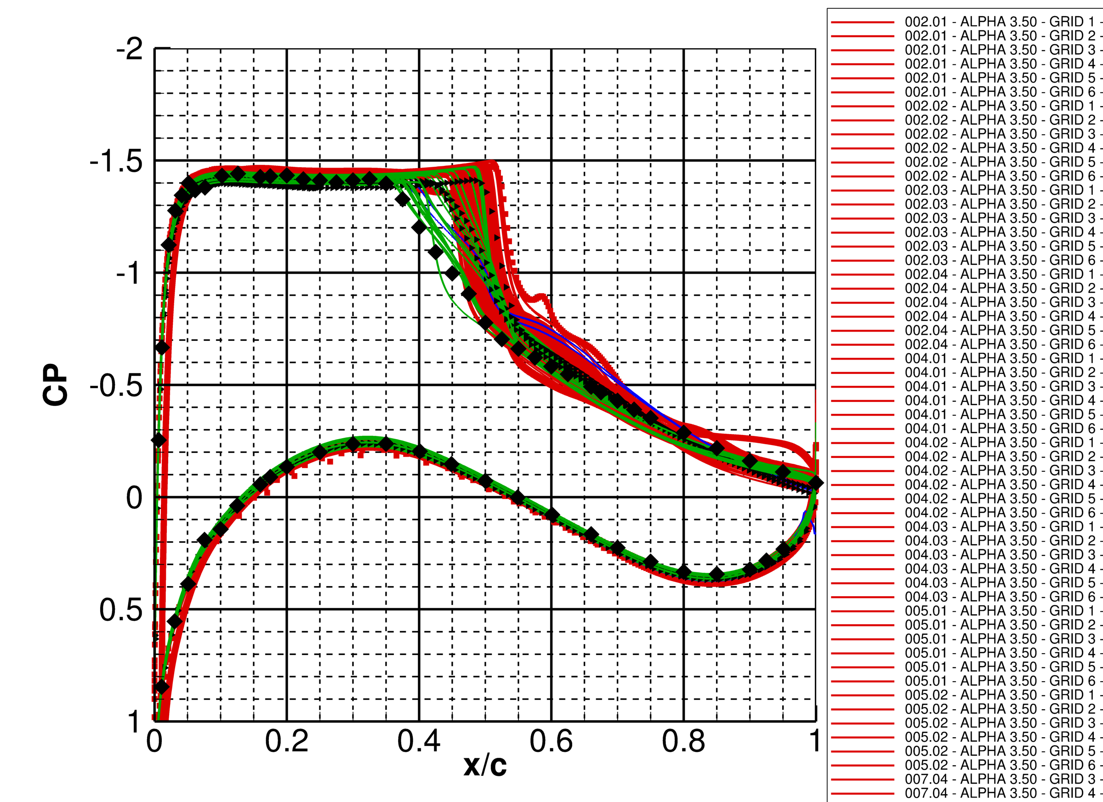
3.50
Red: RANS
Green: URANS
Blue: HRLES
Black Triangles: WMLES

Slide 18
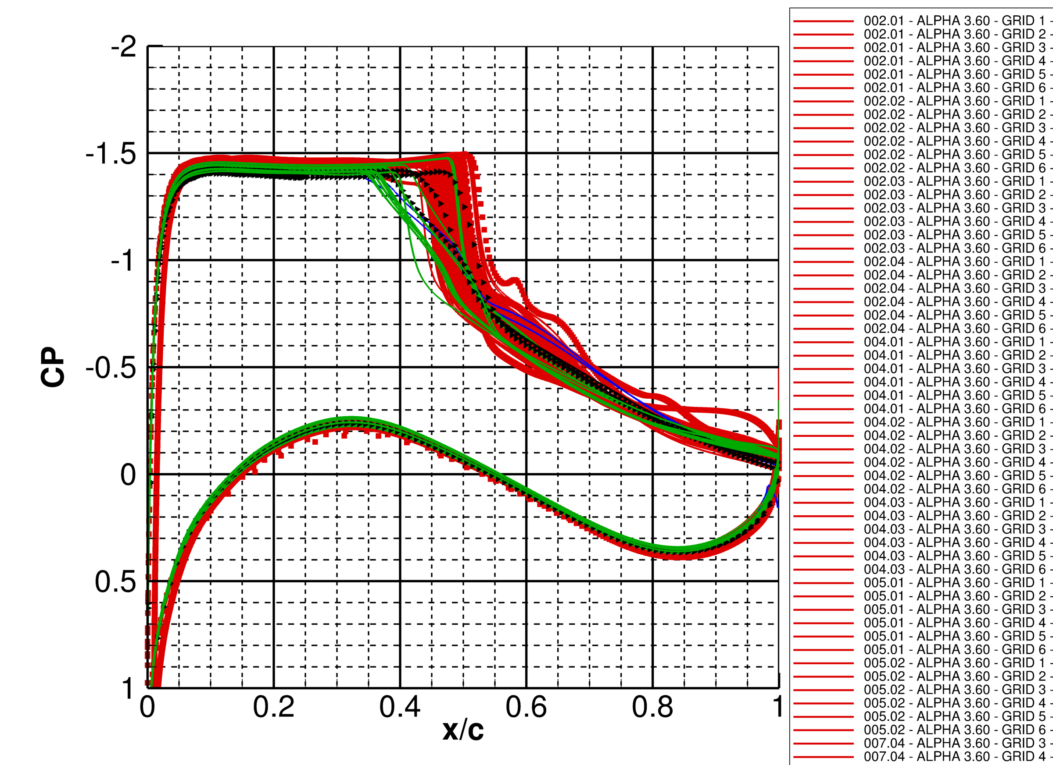
3.60
Red: RANS
Green: URANS
Blue: HRLES
Black Triangles: WMLES

Slide 19
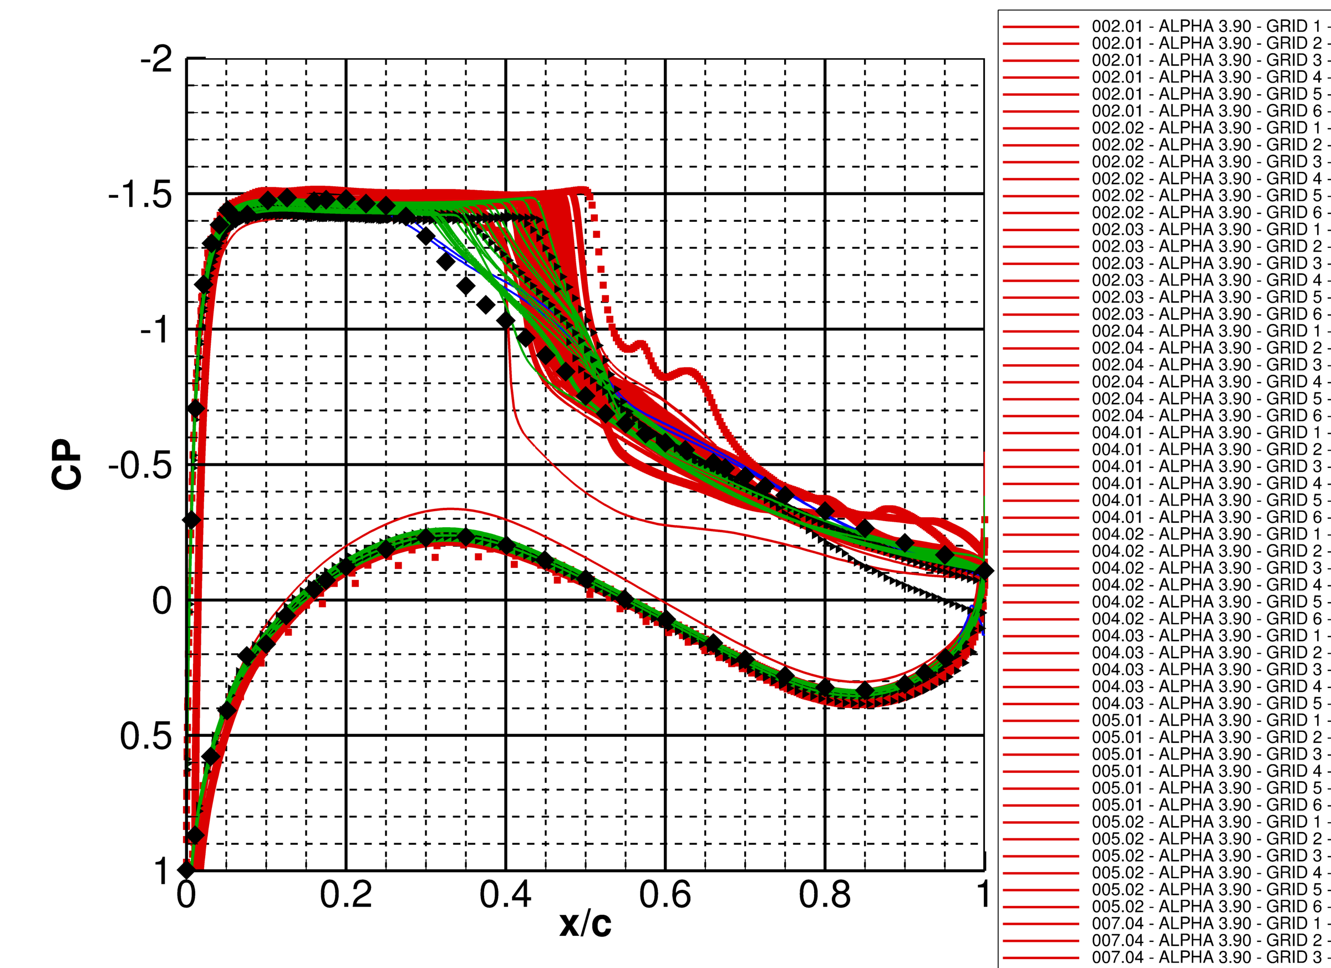
3.90
Red: RANS
Green: URANS
Blue: HRLES
Black Triangles: WMLES

Slide 20
CP RMS Section Cuts

Slide 21
CP RMS Section Cuts (2)

Slide 22
Planned Plots
Test case 1a
Grid study: CL/CD/CM vs GRID_FACT for alpha=1.50, 2.50, 3.10, 3.50, 3.90 deg
Alpha sweep: CL-alpha, CL-CD, CL-CM, average CL-alpha
Sectional Cp (vs EXP): Cp for alpha=2.50, 3.10, 3.50, 3.90 deg
Histogram of average CL/CD/CM vs each participant
Test case 1b :
Grid study: CL/CD/CM vs GRID_FACT for alpha=1.50, 2.50, 3.10, 3.50, 3.90 deg
Alpha sweep: CL-alpha, CL-CD, CL-CM, average CL-alpha
Sectional Cp (vs EXP): Cp-mean and Cp-rms for alpha=2.50, 3.10, 3.50, 3.90 deg
PSD plots for 2.50, 3.10, 3.50, 3.90 deg
Test case 1a vs Test case 1b:
CL-alpha, CL-CD, CL-CM from case 1a and 1b

Slide 23
CP RMS Section Cuts: To-Do
Need to classify data and re-plot based on grid-density of each result
Most participants used their own grids, and so apples-to-apples comparisons will be tricky
Need to classify data and re-plot based on turbulence model, time step, etc.
Plan for similar plots of the PSD data, also

Slide 24

aiaabuffet@gmail.com

Slide 25
Backup

